Slide 1

Dungeons & Dragons
Created By :
Lucas Aho
Alex Hampton
Nicole Heersink
Notes:
Good evening!
Please Join us on this quest through our Dungeons & Dragons application for Dungeon Masters and their players.
Which was created by Lucas Aho, Alex Hampton and Nicole Heersink

Slide 2
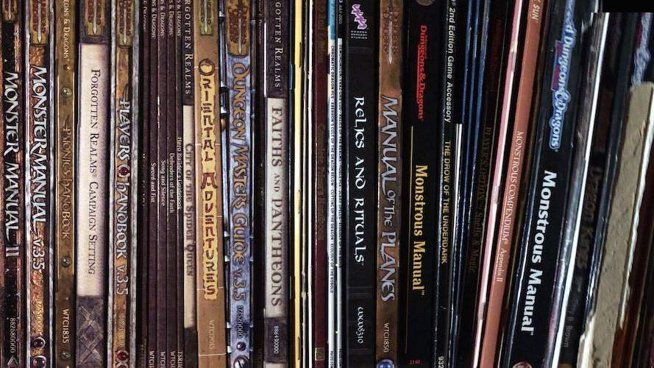
Purpose
To give Dungeons & Dragons players and Dungeon Masters a place to create their characters, manage the NPCs, navigate the party’s campaign and communicate with the party.
Notes:
Our main purpose was to create an easy to use APPLICATION for Dungeon Masters and Players to stay organized, navigate through their Profiles and have some communication with the party.
We want this application to be useful for the many players around the world to be connected on one app.
As well as have resources available to them at their fingertips.

Slide 3
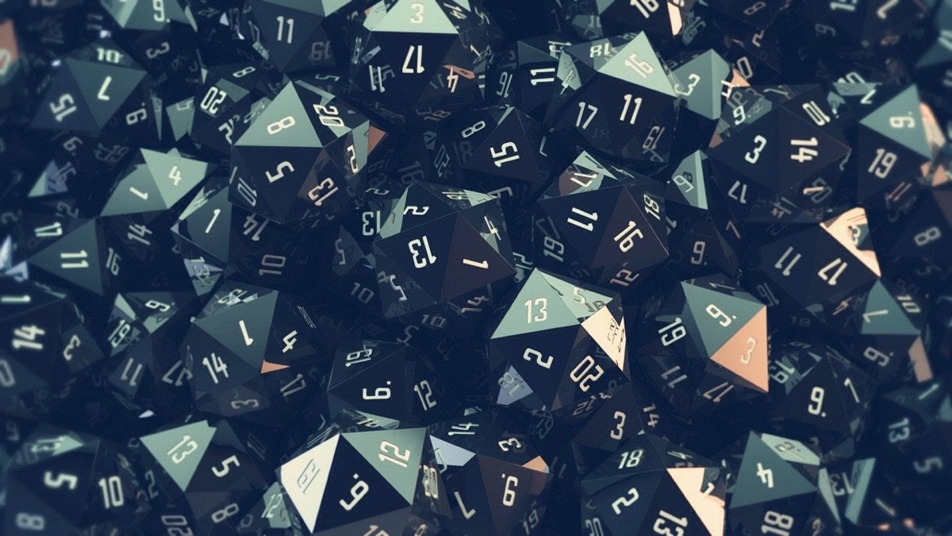
Motivation
Dungeon masters:
Navigate the campaign and oversee the party’s details
Players:
Creation of character profiles and communicate with the party
Notes:
Our motivation behind creating the DnD application was inspired by a Dungeon Master who wanted to have an easy to use resource page when leading a party.
He wanted to be able to navigate the campaign by knowing what was nearby in the location of the party.
We created a page for
dungeon masters to:
create new NPCs
Navigate the locations
oversee the party
communicate with the party
Players to:
Create their characters
And communicate with the party

Slide 4

Responsibilities
Alex:
Frontend and style
Lucas:
authentication with new tech, database management, & sequelize models.
Nicole:
File structure, chat & JavaScript
Notes:
Lucas (Inspired DM)
Alex
ME
But Ultimately we worked together to tackle the issues that arose in building such a big application.
Which Alex will talk more about after the demo.

Slide 5
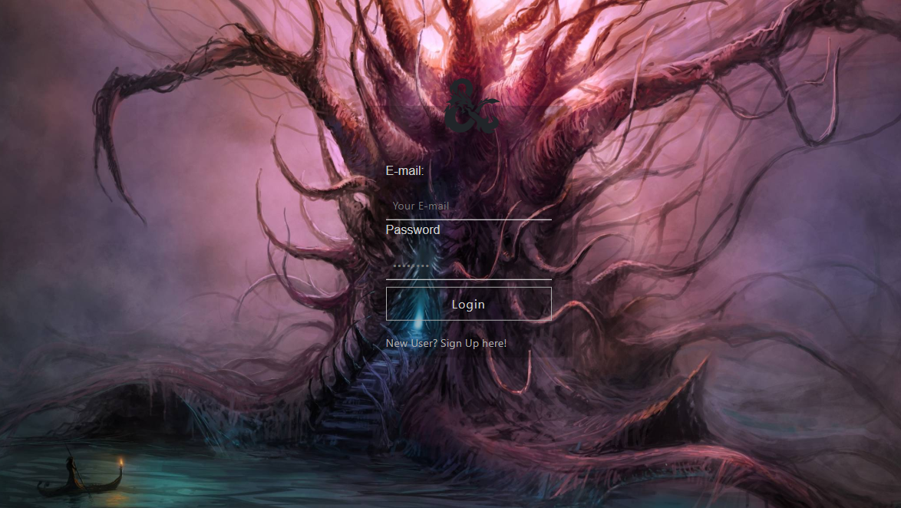
Results
We have created a secure login page with authentication that determines which home page the user has access to. On those pages we have functionality and a few fun option.
Well lets just show you.
Notes:
We have created a secure login page with authentication that determines which home page the user has access to. On those pages we have functionality and a few fun option.
Nicole intro demo/lucas

Slide 6
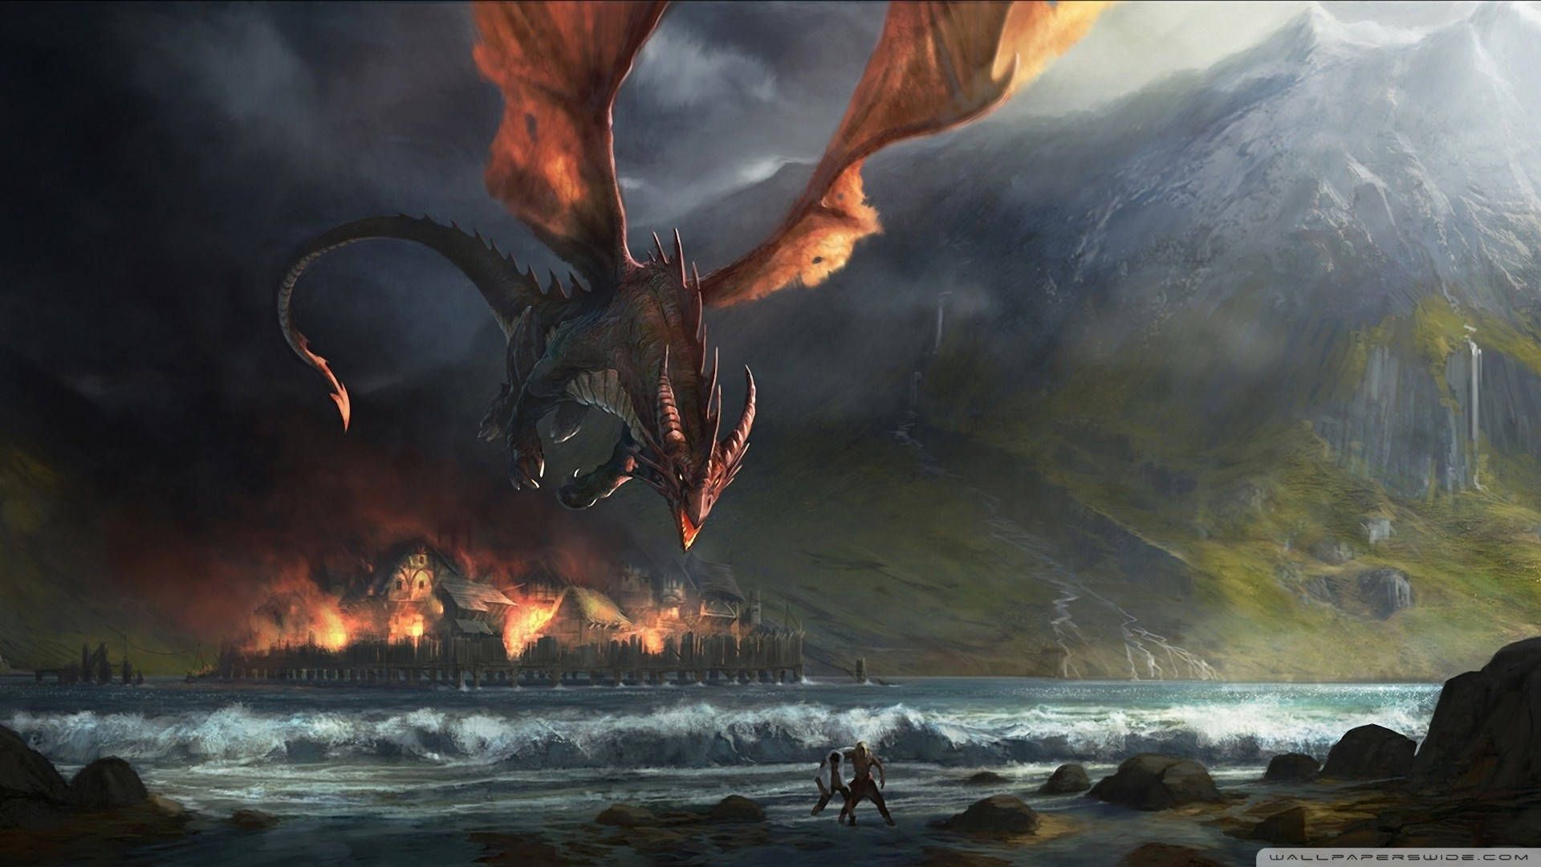
Challenges
Scope with all the layers for this app
Handlebars
Integrating chat API/ Chatkit
& Dragons

Slide 7

Future Improvements
Add battel grid for both users
Implement a chatkit to handle the data and features of the chat
Add a dice roller and a CR calculator

Slide 8

Technologies
Sequelize
Axios
Handlebars
MySQL
Bcrypt password encryption
DnD5e API

Slide 9

Thank you for your time
We hope you enjoyed our presentation.
Questions?

